Slide 1

Let's be Friends The Newtella Way by Alyssa
Notes:
Continueing from my big idea, “the newtellla way”(aka the new way of eating Nutella).
I wanted to approch by adiences in a fun and adventurous way. Thus, coming out with the campaign title “Let's be Friends, the Newtella Way”.

Slide 2
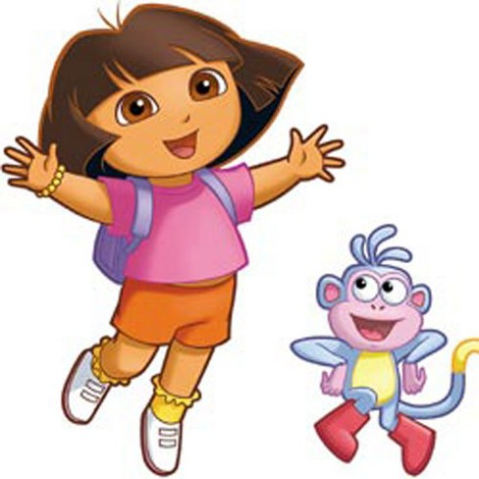

Concept
Notes:
The concept is like Dora the Explorer going on an adventure.
Nutella is a character who wants to find his long lost friends, which are the different chocolate dessert choices in the world.
For my execution I have only illustrate 2 other desserts, which is a Jelly and a Donut as an example.But there can be unlimited other desserts that can be illustrated to be in the exeuction.

Slide 3

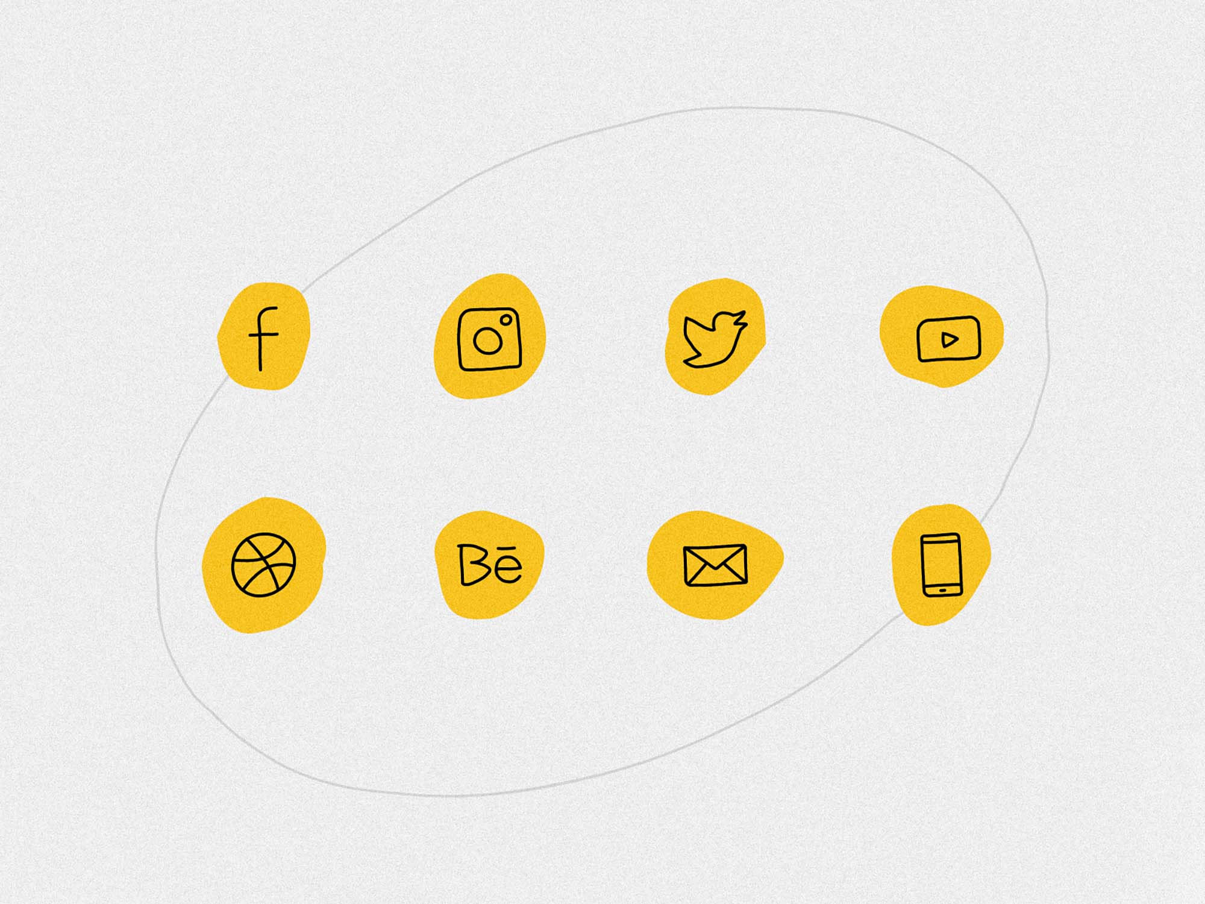



mediums
Notes:
So before diving into the main point, here are the 5 mediums that I will be using... which are Mobile App, Social Media, Pakcaging, Poster and Event.

Slide 4
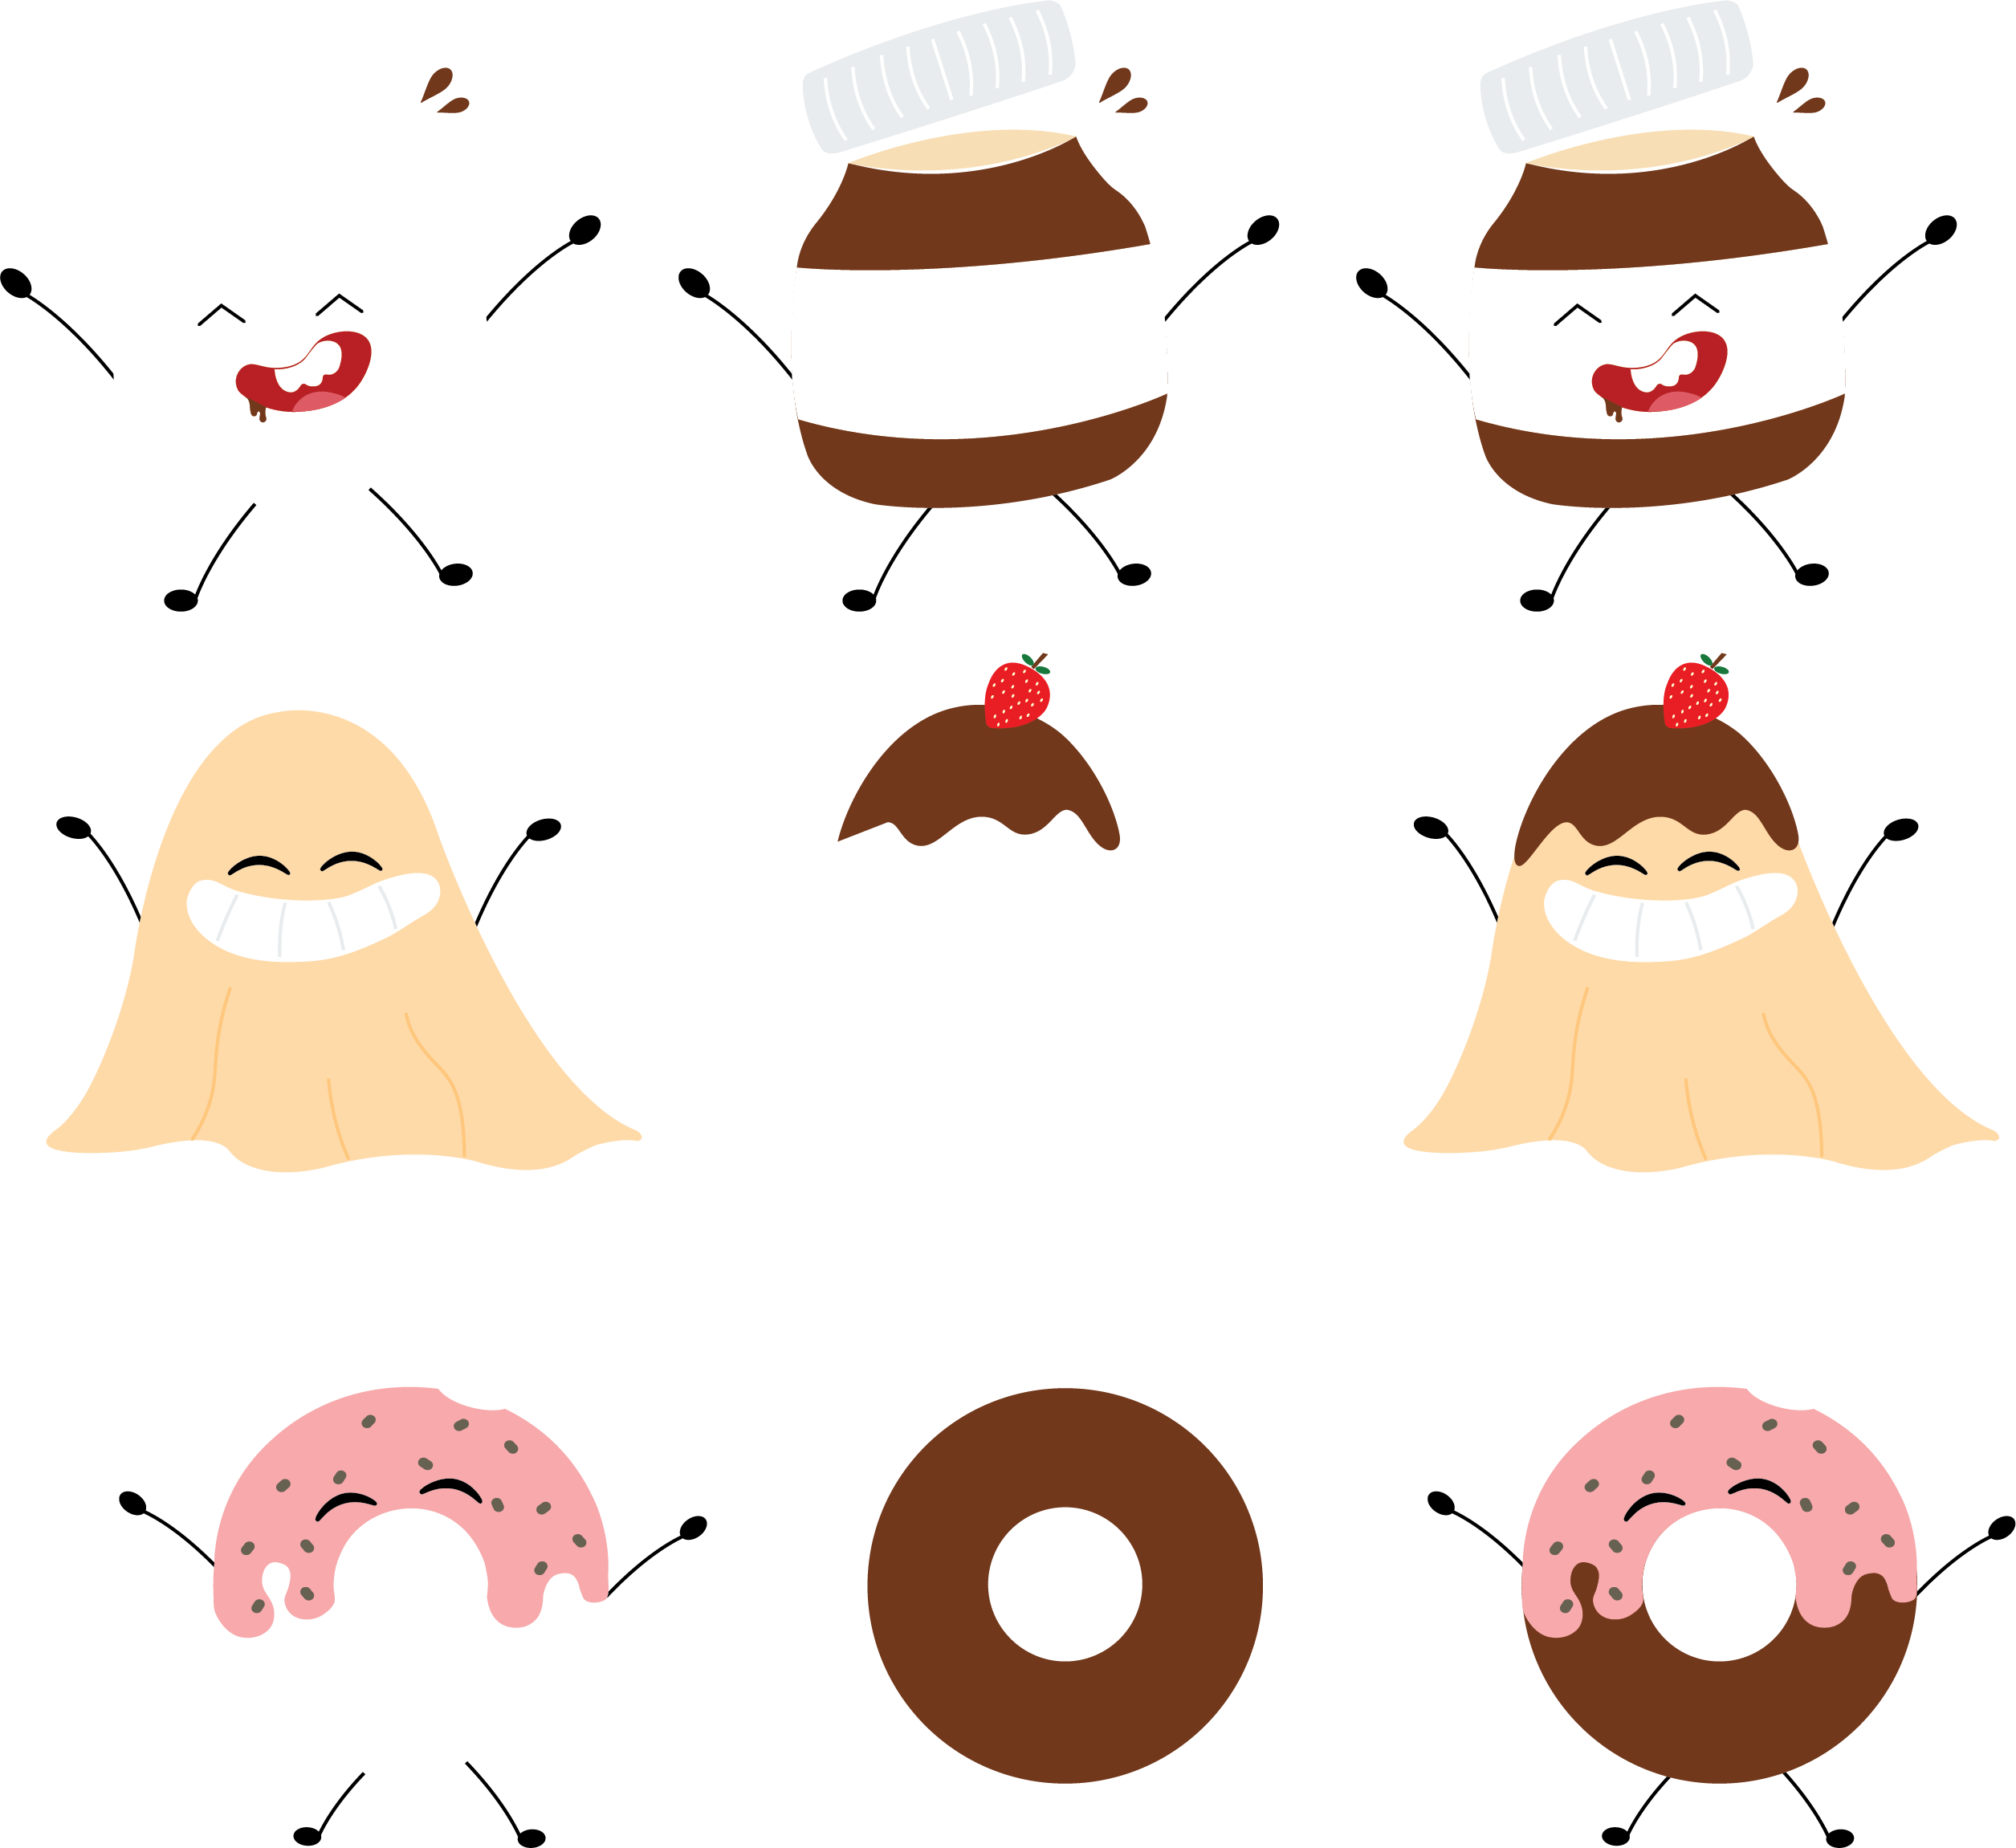
Mascots
Notes:
Ok! Let's introduce the Mascot's. There are 3 main ones, which is Nutella, Jelly and Donut.
When a Happy boy meets Nutella=Happy Nutella
When a bald jelly meets Nutella=Nutella Jelly
and so forth...

Slide 5
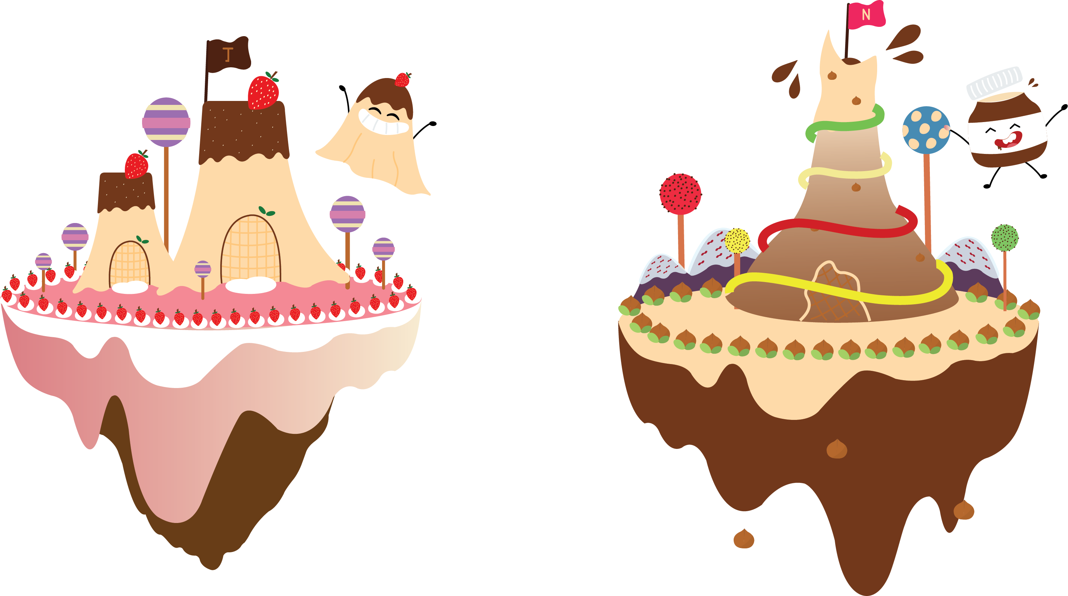
Kingdom
Notes:
And each Macot has its own Kingdom that suits its theme. Inside the Kingdom there will be different stories awaiting for the customers to discover. So i know everything is still kind of confusing... but bear with me, Im about to explain everything to you.

Slide 6
Mobile app

Slide 7


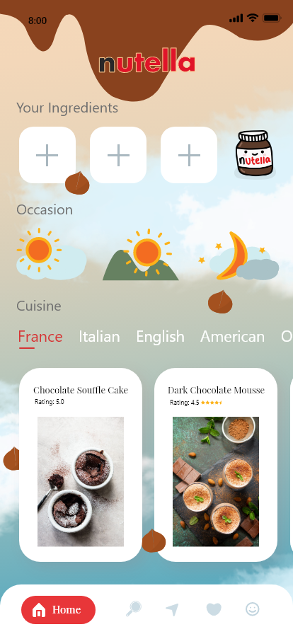
Notes:
This mobile app has two main functions:
To search for recipes and a storytelling session for parents and kids time.
How it works is like this...Once the app launches it will show the Nutella logo with a question mark. then it will turn into Newtella which is introducing a neew way of eating Nutella.
The main page which is number 3. A lot of moms have a problem where they have a lot of ingredients at home, but they don't know how to use it or what to make out of it. That's why, my app solves their problem. Mom's know can add in the ingriedients that they have by simple clicking the + button. They can add up to 3 ingridients. They can also choose what kind of occasion. Such as do they want it as Breakfast, Lunch or Dinner. And also choose the cuisin such as France dessert, Italian dessert and so forth. After picking all of it, the app will generate some options that meets with the criteria for mom's to pick from.

Slide 8
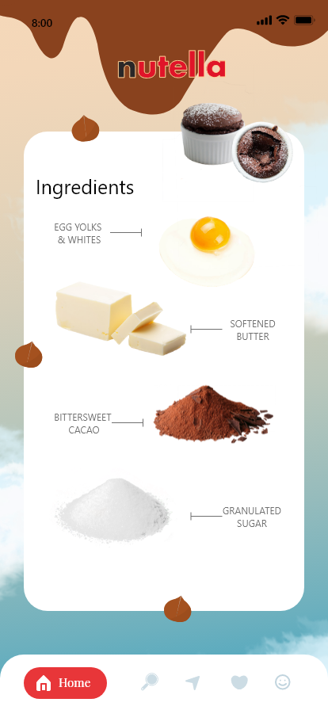
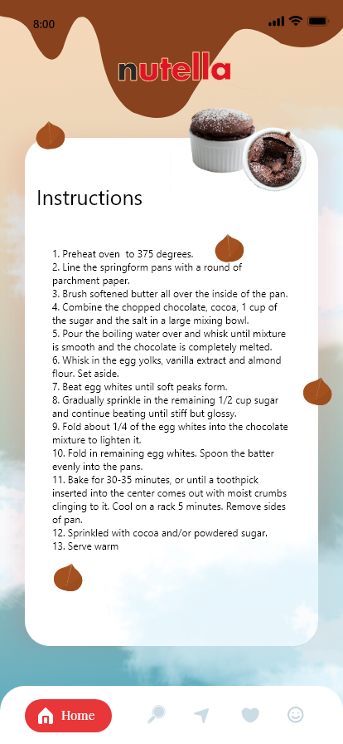
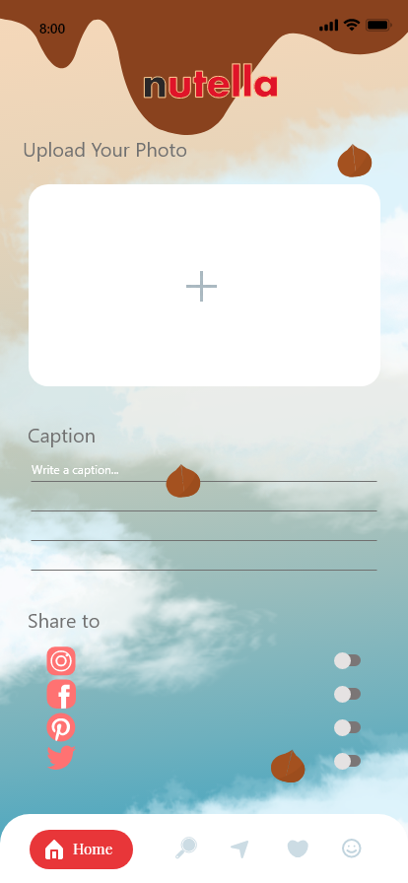
Notes:
After choosing the dessert they want to make, the app will redirect them to the ingredients page, and instruction page. Lastly, after actually making the dessert, mom's have the option to upload their photos of the dessert into the app and share it with the world. This is good cuz it also creates a mom society that will be talking about what nutella dessert they made and how they felt about it.

Slide 9
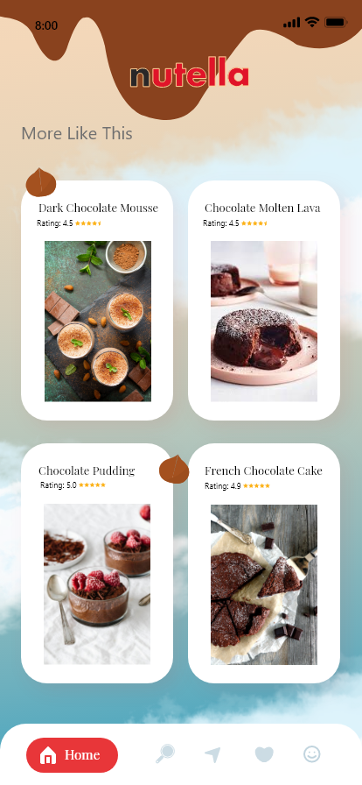
Notes:
After everything, there will also be a suggestion page to make the next dessert.

Slide 10
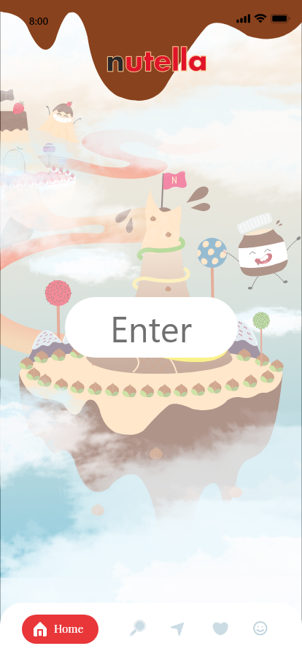
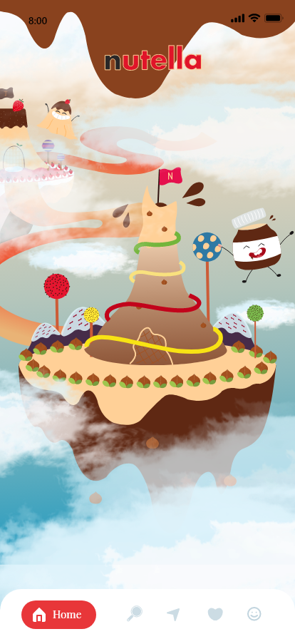
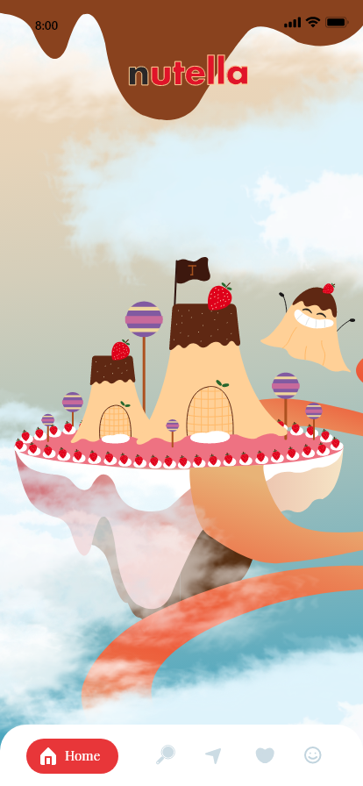
Notes:
Aside from having a recipe app, the app also has a session where Mom's and kids can play and follow along with some interesting stories that are connnected with the mascot's that i talked about earlier.
Once they first login, they will see page , which is level 1. Each level uploacks 5 Chapters of the story.
so in order to read Chapter 6-10, they have to level up to unlock the next level.

Slide 11


Level up
You need 100points to level up
Buy 1
100 points
Make 1
50 points
Notes:
This will encourage the consumers to try out new newtella recipes at the same time boost some sales.

Slide 12
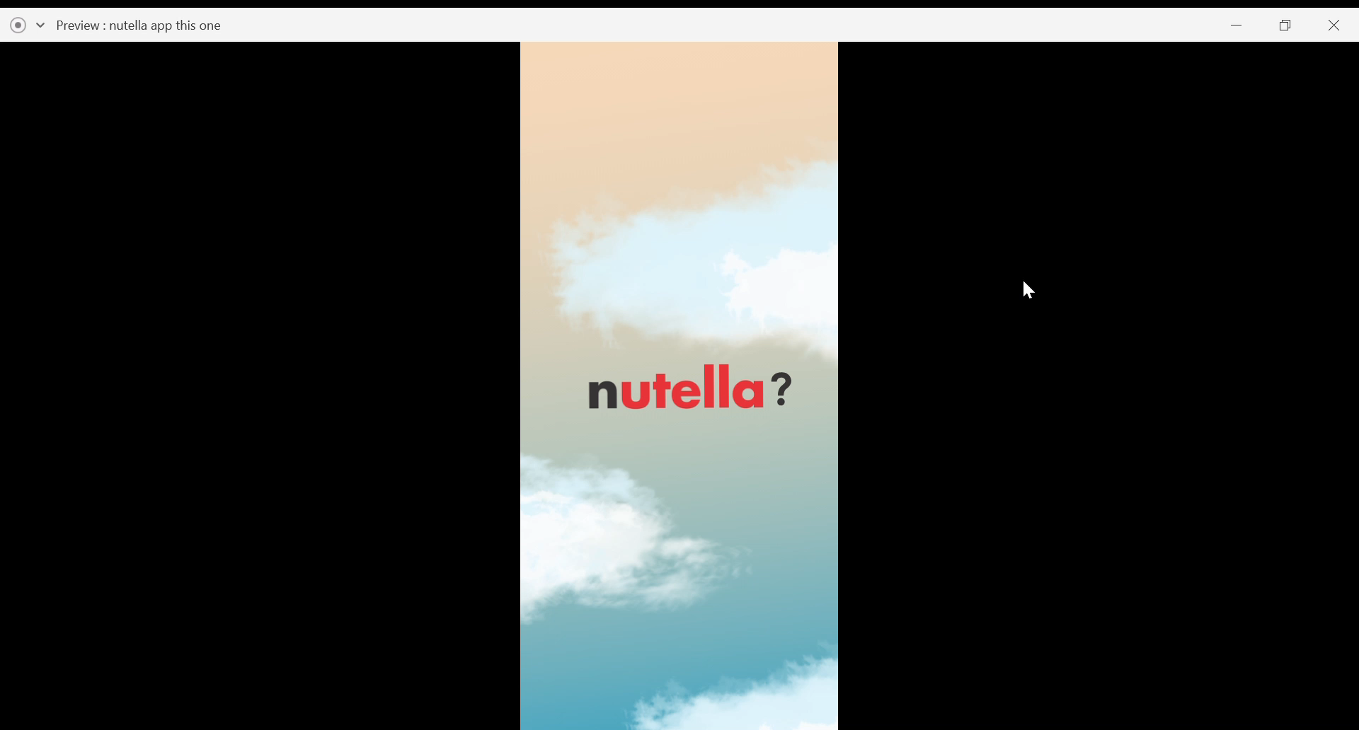

https://xd.adobe.com/view/c54a36ad-9017-4bdb-48ca-808a76a84b97-b37b/
Notes:
Let's have a look at the actualy app
https://xd.adobe.com/view/c54a36ad-9017-4bdb-48ca-808a76a84b97-b37b/

Slide 13
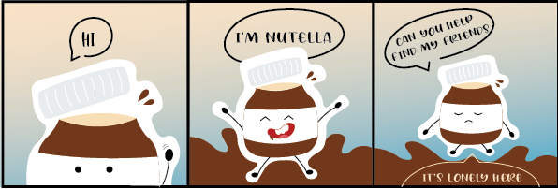
Social Media
Notes:
Next, social media.
Using the main mascot, Newtella..create a mini online interaction.

Slide 14
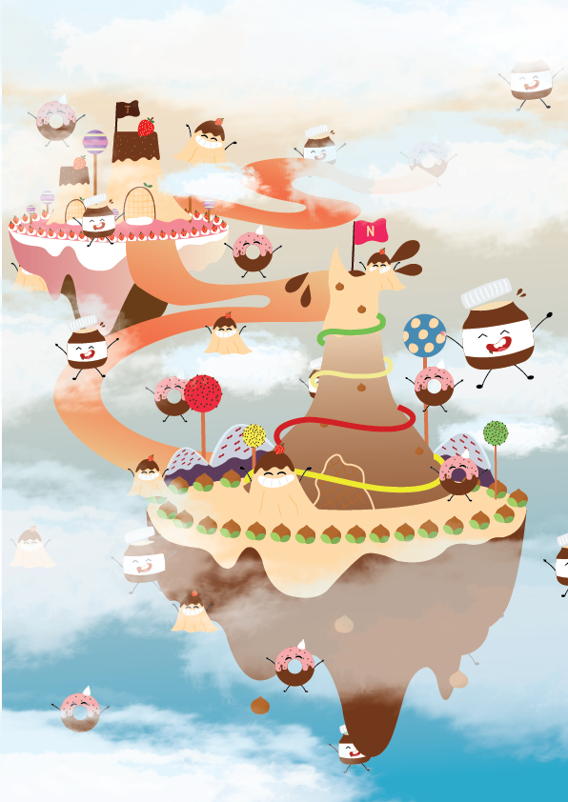
Social Media
Notes:
the game is to count the numbers of mascots, nutella, jelly and donut that appeared in the 9 post. So the 9 post will form a big picture. This design is used in the app and reused here so that it connects together. And those who read the storybook will also be excited to play a game of the same mascots because they feel connected.

Slide 15
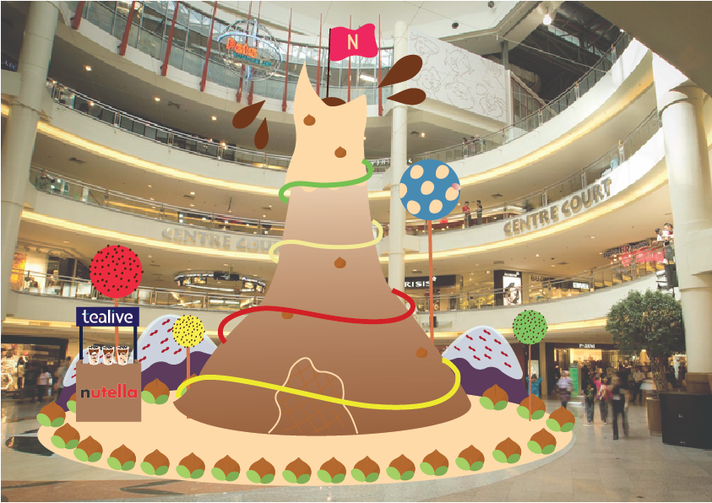
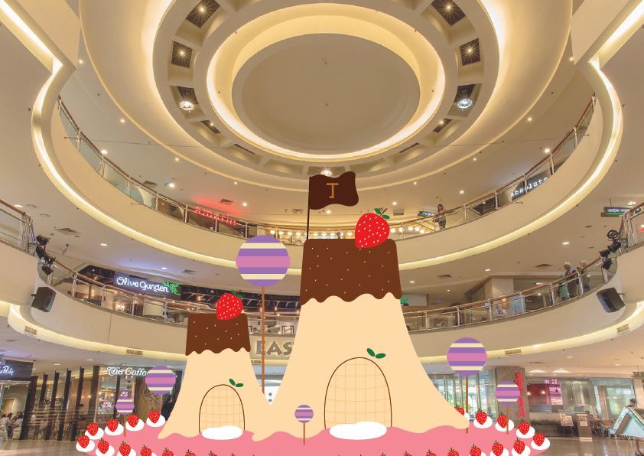


Event
x
Notes:
Also incorporating the Kingdom design from the app, There will be a Pop-up store in Midvalley.
So there will be 3 Kingdoms scattered around Midvally. One could be in the Centre Court, one in the east courst and one in the west court and different levels.
This is because I want to incorporate the idea of trussure hunt here too. So customers have to search for different levels to find the event.

Slide 16
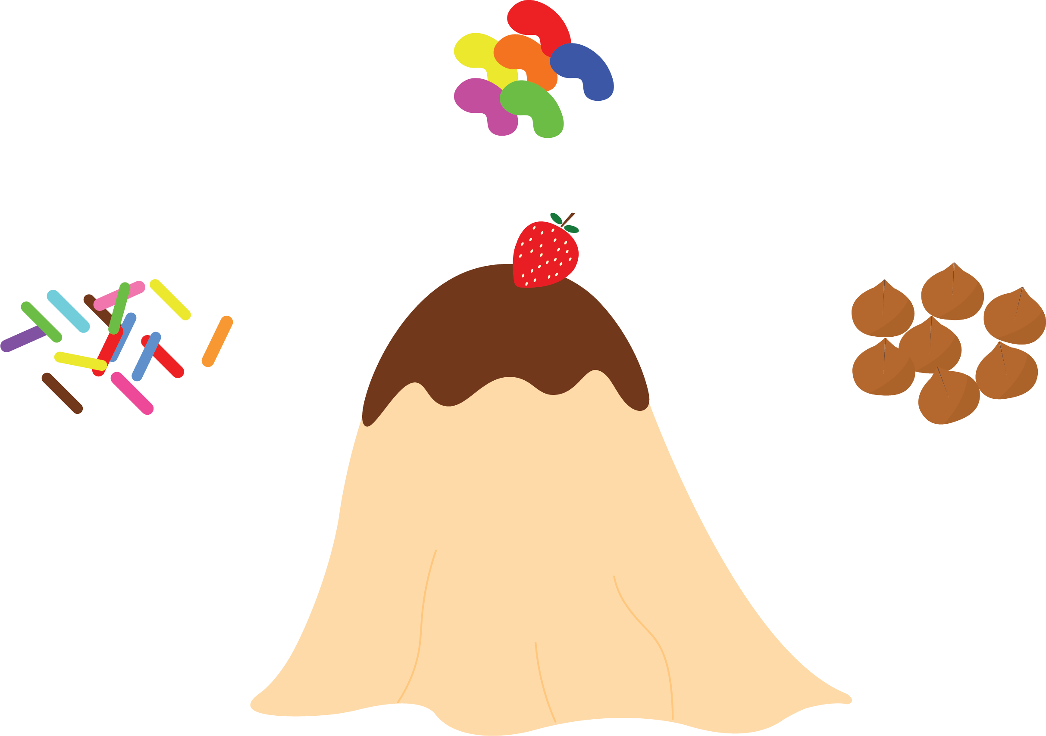
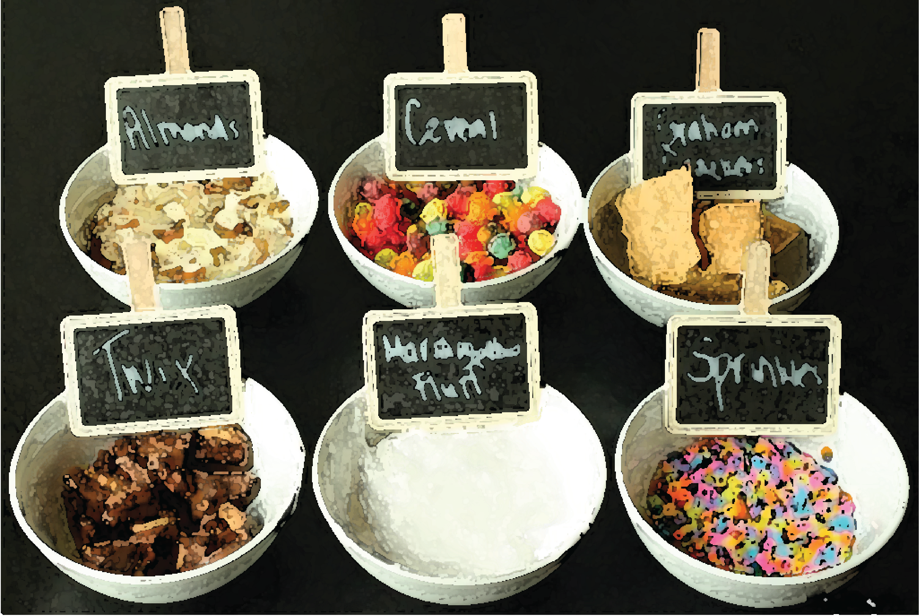
Event
x
Notes:
Inside each pop-up store, families can enter inside and make delicious nutella desserts with the guides of the promoters there. For example, if they went into a Jelly popup store, the promoters there will teach them to make Nutella jelly on the spot that they can bring back to eat. They can also choose different topings to go with the Jelly.
This is a fun and interactive way of teaching families that you can eat Nutella differently and deliciously.

Slide 17
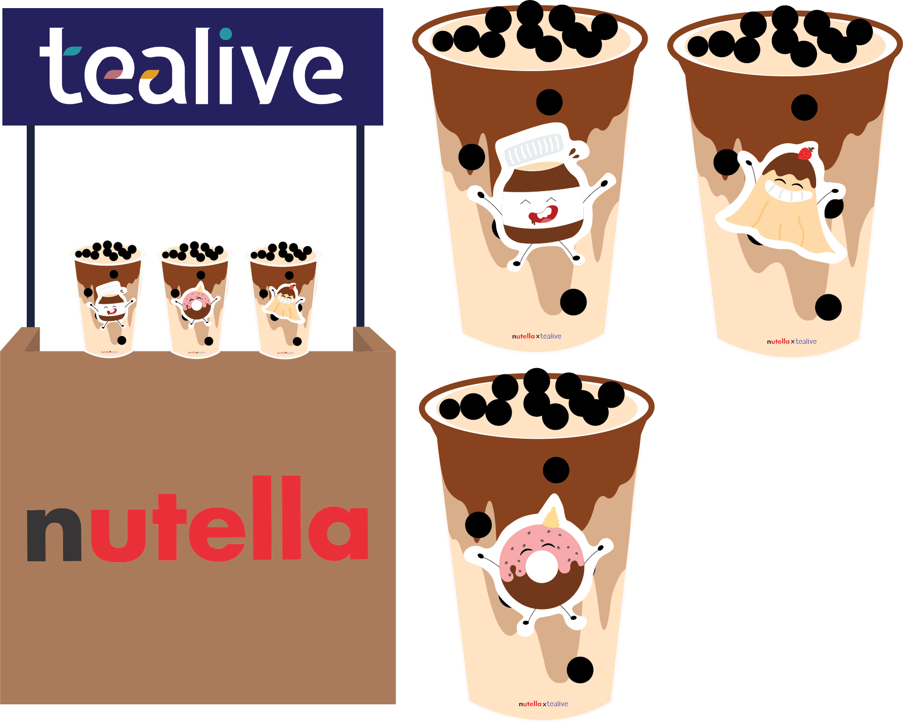
Event
First 100 customers
get a free drink
x
Notes:
In the event, Nutella will also collaborate with Tealive to serve a limited edition “Nutella Tealive Drink”.
The first 100 customers will get a free drink.
On top of the cup packaging, I also added in the different mascot to attrack the children.

Slide 18
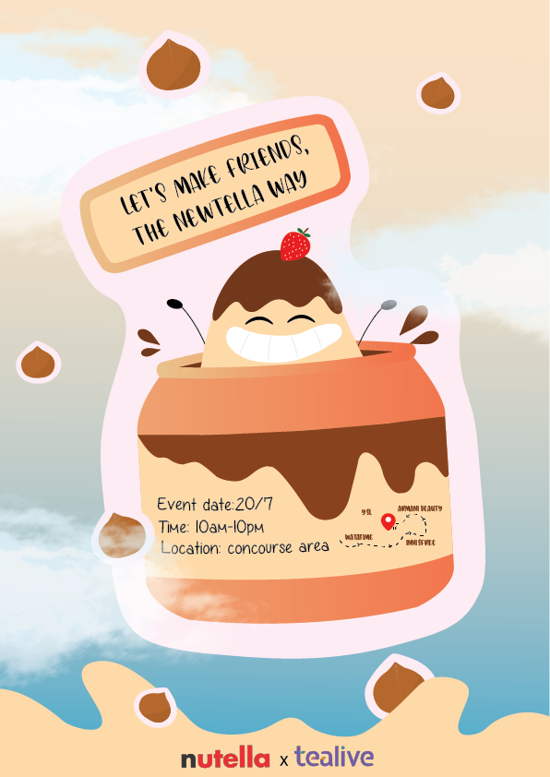
Poster
Target anyone
who is shopping
Notes:
In order to promote the event, there will be posters placed around the shoping mall to target those who are shopping

Slide 19
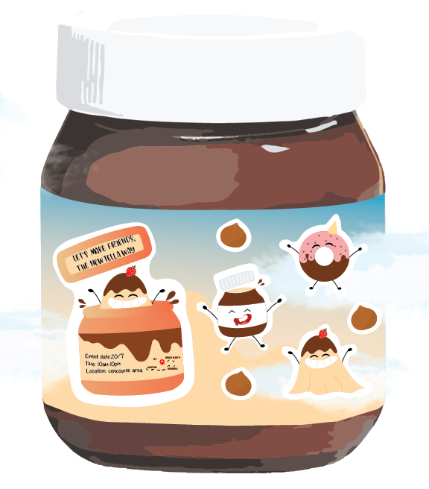
Packaging
v
Stickers for kids
Event information
Target current Nutella customers
Notes:
and also on Nutella Packaging. SO This will be in the market 3 months before the launch of the event. This is to target the current nutella customers

Slide 20
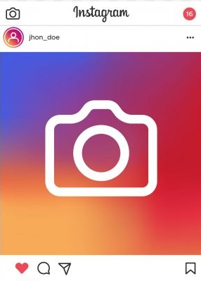
Social Media
Reach potential customers
Notes:
and the poster will also be posted on social media to target new potential customers.

